Slide 1

Texture: statistical models of vision
Somewhere in Cinque Terre, May 2005
CS180: Intro to Computer Vision and Comp. Photo
Alexei Efros, UC Berkeley, Fall 2025

Slide 2
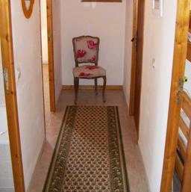

Object recognition Is it really so hard?
Find the chair in this image
Output of normalized correlation
This is a chair
Slide by Antonio Torralba

Slide 3
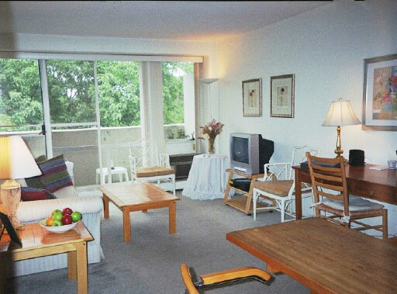

Object recognition Is it really so hard?
Find the chair in this image
Slide by Antonio Torralba

Slide 4
Recognition: Instance vs. Category
Instance recognition:
“Find me this particular chair again”
Often simple template matching works OK
Even better with many small templates, a.k.a. feature descriptors
Category recognition:
“find me all chairs”
Templates don’t work. Why?
Focus on things that might be invariant across the category
Relates to concept of “texture”

Slide 5
What is Texture?
Texture depicts spatially repeating patterns
Many natural phenomena are textures
radishes
rocks
yogurt

Slide 6
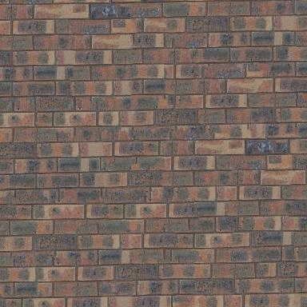
When are two textures similar?

Slide 7
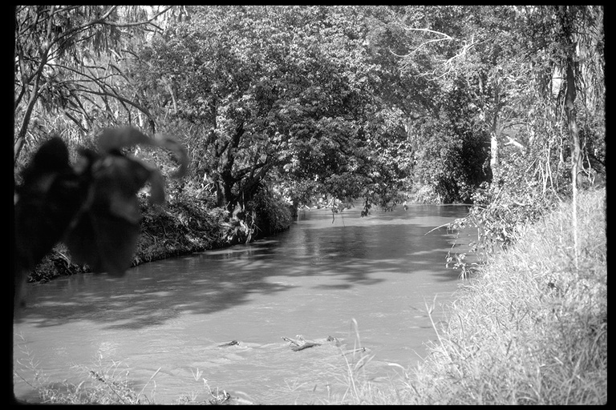
Texture as “stuff”
Source: Forsyth

Slide 8
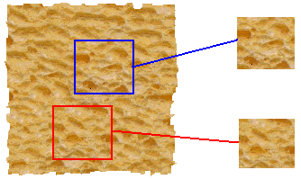
Texture Analysis
“Same” or “different”
ANALYSIS
True (infinite) texture
Compare textures and decide if they’re made of the same “stuff”.

Slide 9
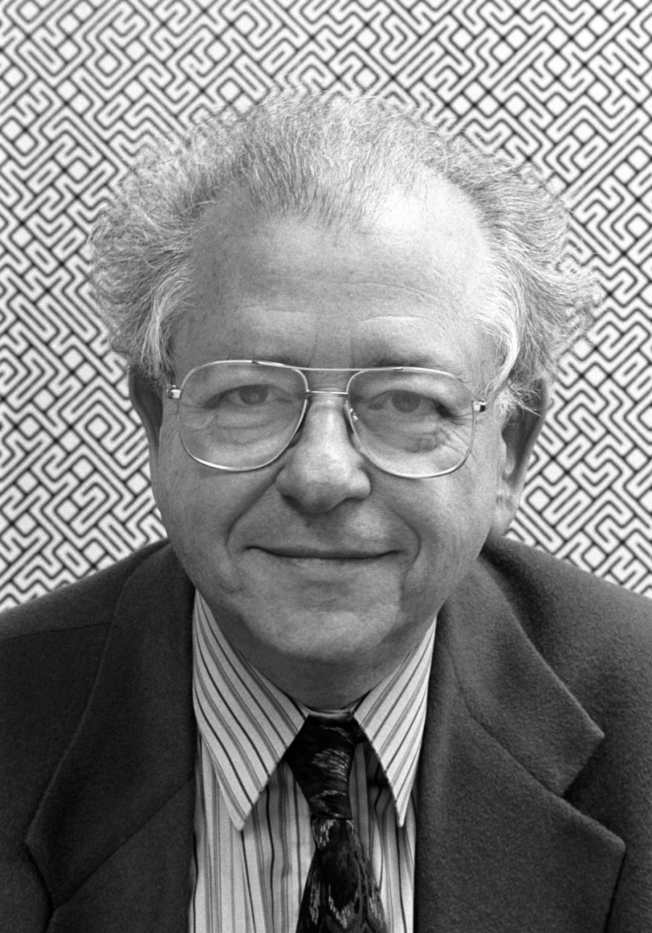
Béla Julesz, father of texture

Slide 10
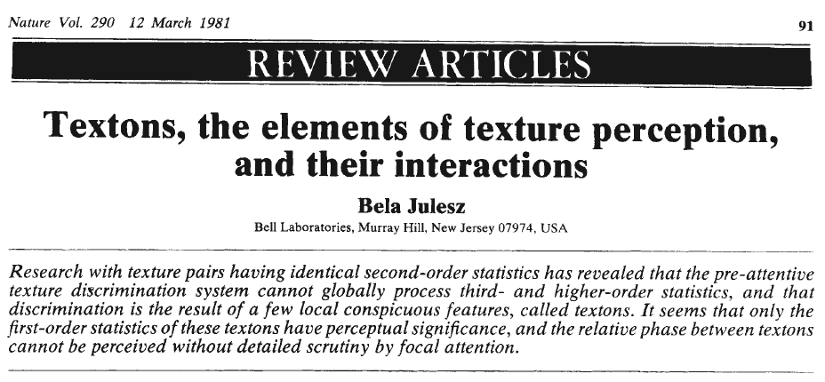
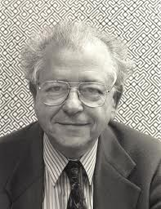
Bela Julesz, "Textons, the Elements of Texture Perception, and their Interactions". Nature 290: 91-97. March, 1981.

Slide 11
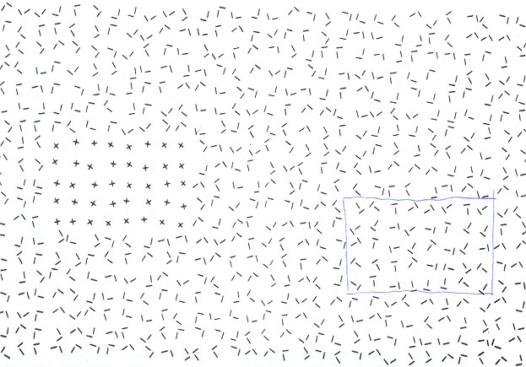
Texton Discrimination (Julesz)
Human vision is sensitive to the difference of some types of elements and
appears to be “numb” on other types of differences.

Slide 12
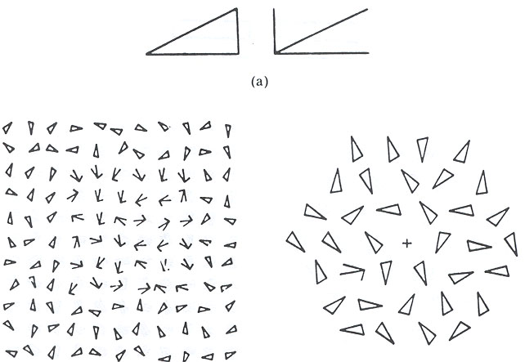
Search Experiment I
The subject is told to detect a target element in a number of background elements.
In this example, the detection time is independent of the number of background elements.

Slide 13
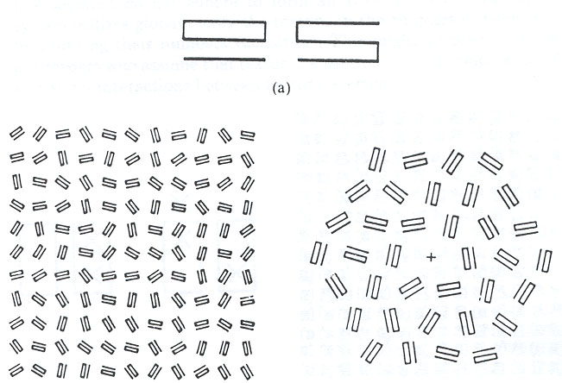
Search Experiment II
In this example, the detection time is proportional to the number of background elements,
And thus suggests that the subject is doing element-by-element scrutiny.

Slide 14
Preattentive vs Attentive Vision (Julesz)
Human vision operates in two distinct modes:
1. Preattentive vision
parallel, instantaneous (~100--200ms), without scrutiny,
independent of the number of patterns, covering a large visual field.
2. Attentive vision
serial search by focal attention in 50ms steps limited to small aperture.

Slide 15
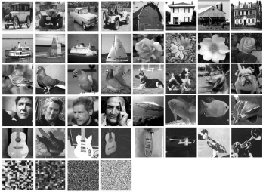
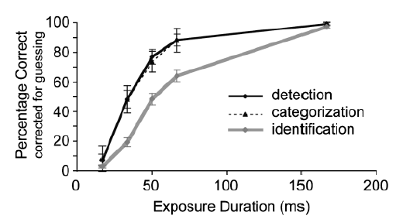
Evidence for Pre-attentive Recognition (Thorpe)
On a task of judging animal vs no animal, humans can make mostly correct saccades in 150 ms (Kirchner & Thorpe, 2006)
Comparable to synaptic delay in the retina, LGN, V1, V2, V4, IT pathway.
Doesn’t rule out feed back but shows feed forward only is very powerful
Detection and categorization are practically simultaneous (Grill-Spector & Kanwisher, 2005)

Slide 16
Julesz Conjecture
Textures cannot be spontaneously discriminated if they have the same first-order and second-order statistics of texture features (textons) and differ only in their third-order or higher-order statistics.

Slide 17
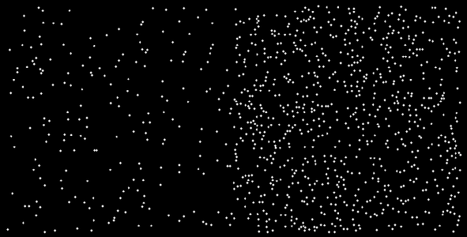
1st Order Statistics
5% white
20% white

Slide 18
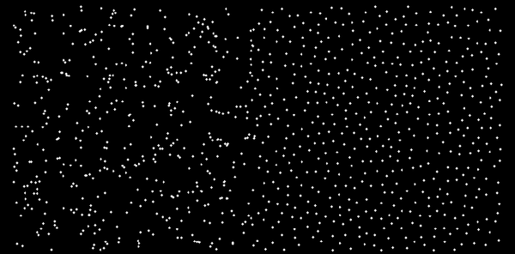
2nd Order Statistics
10% white

Slide 19
Big Question
What is the statistical unit (texton) of texture in real images?

Slide 20
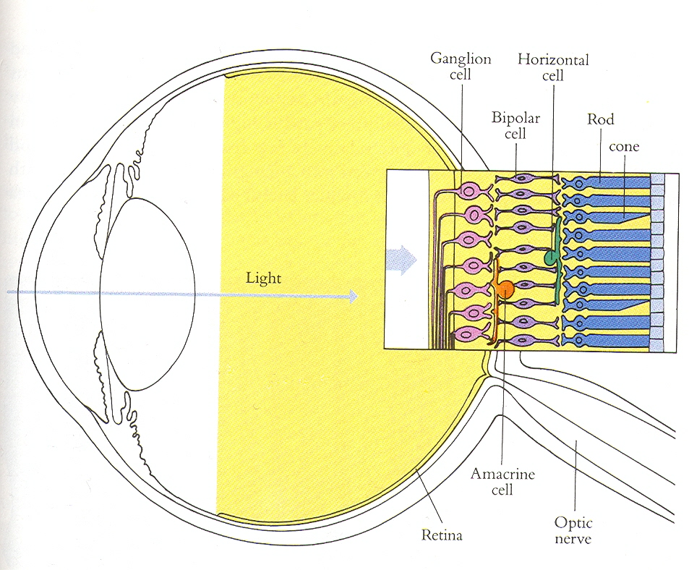

Slide 21
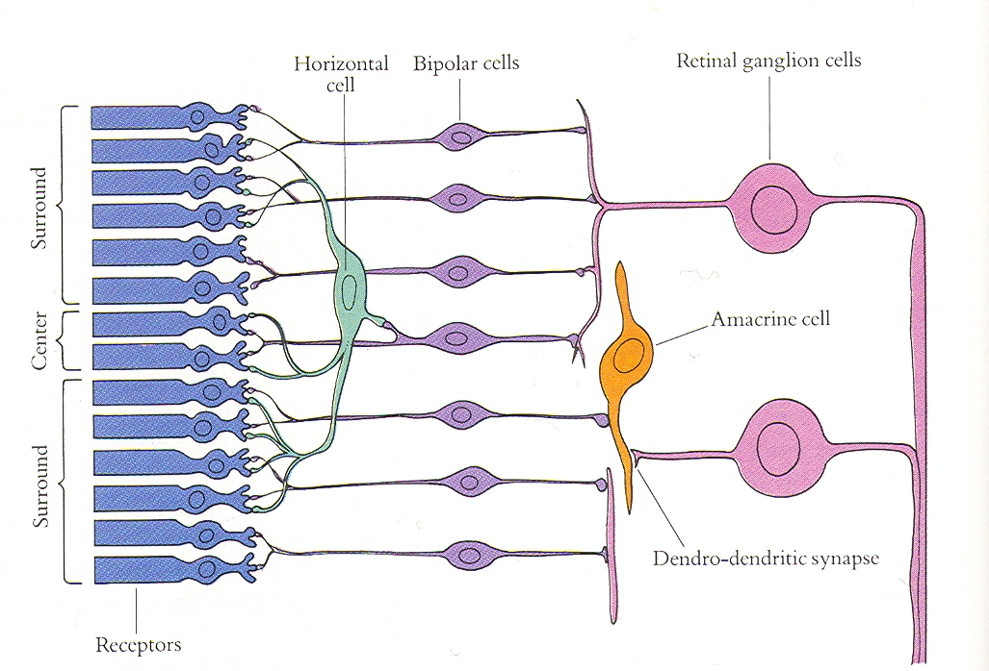

Slide 22
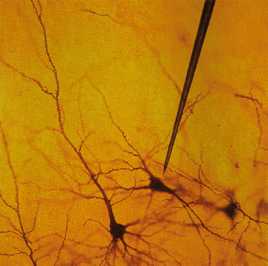
Single Cell Recording
© Stephen E. Palmer, 2002

Slide 23
Single Cell Recording
Microelectrode
Amplifier
Electrical response
(action potentials)
mV
© Stephen E. Palmer, 2002

Slide 24
Retinal Receptive Fields
Receptive field structure in ganglion cells:
On-center Off-surround
Stimulus condition
Electrical response
© Stephen E. Palmer, 2002

Slide 25
Retinal Receptive Fields
Receptive field structure in ganglion cells:
On-center Off-surround
Stimulus condition
Electrical response
© Stephen E. Palmer, 2002

Slide 26
Retinal Receptive Fields
Receptive field structure in ganglion cells:
On-center Off-surround
Stimulus condition
Electrical response
© Stephen E. Palmer, 2002

Slide 27
Retinal Receptive Fields
Receptive field structure in ganglion cells:
On-center Off-surround
Stimulus condition
Electrical response
© Stephen E. Palmer, 2002

Slide 28
Retinal Receptive Fields
Receptive field structure in ganglion cells:
On-center Off-surround
Stimulus condition
Electrical response
© Stephen E. Palmer, 2002

Slide 29
Retinal Receptive Fields
Receptive field structure in ganglion cells:
On-center Off-surround
Stimulus condition
Electrical response
© Stephen E. Palmer, 2002

Slide 30
Retinal Receptive Fields
RF of On-center Off-surround cells
© Stephen E. Palmer, 2002

Slide 31
Retinal Receptive Fields
RF of Off-center On-surround cells
Surround
Center
© Stephen E. Palmer, 2002

Slide 32
Retinal Receptive Fields

Slide 33
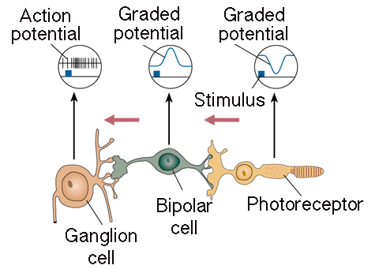
Retinal Receptive Fields
Receptive field structure in bipolar cells
Light
© Stephen E. Palmer, 2002

Slide 34
Retinal Receptive Fields
Receptive field structure in bipolar cells
© Stephen E. Palmer, 2002

Slide 35
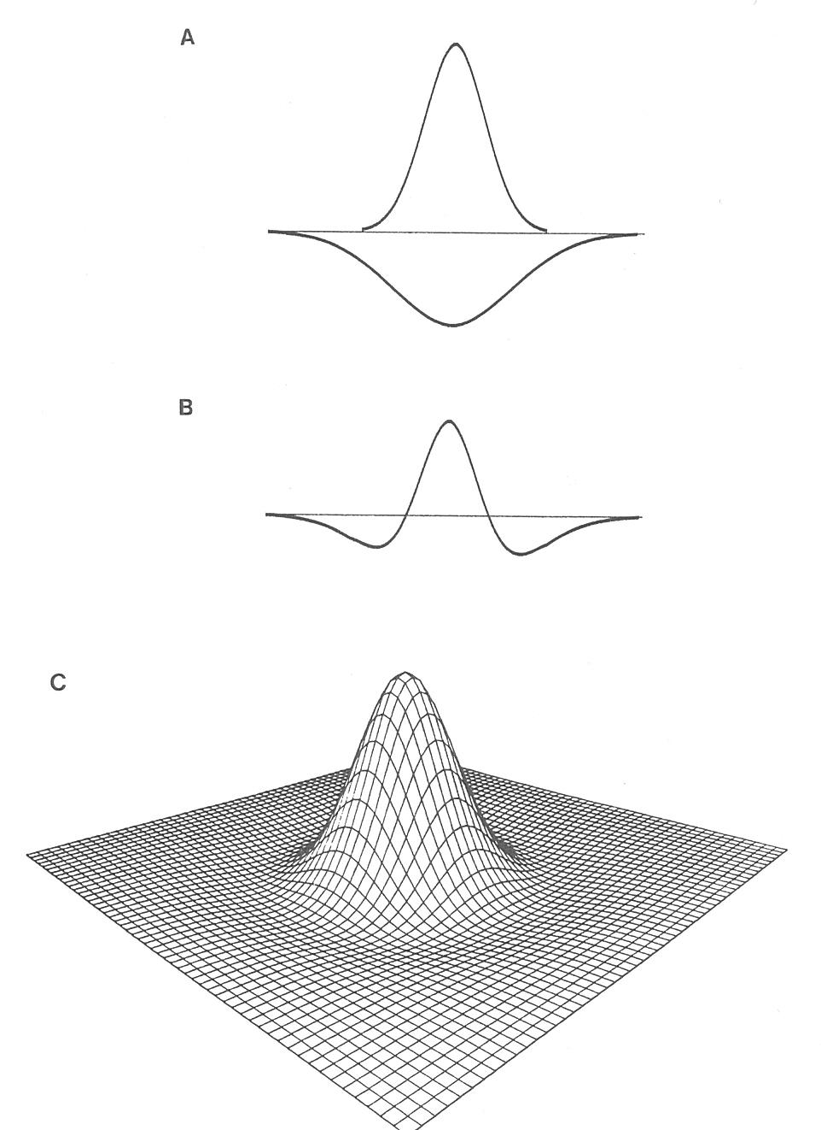

The receptive field of a retinal ganglion cell can be modeled as a “Difference of Gaussians”

Slide 36
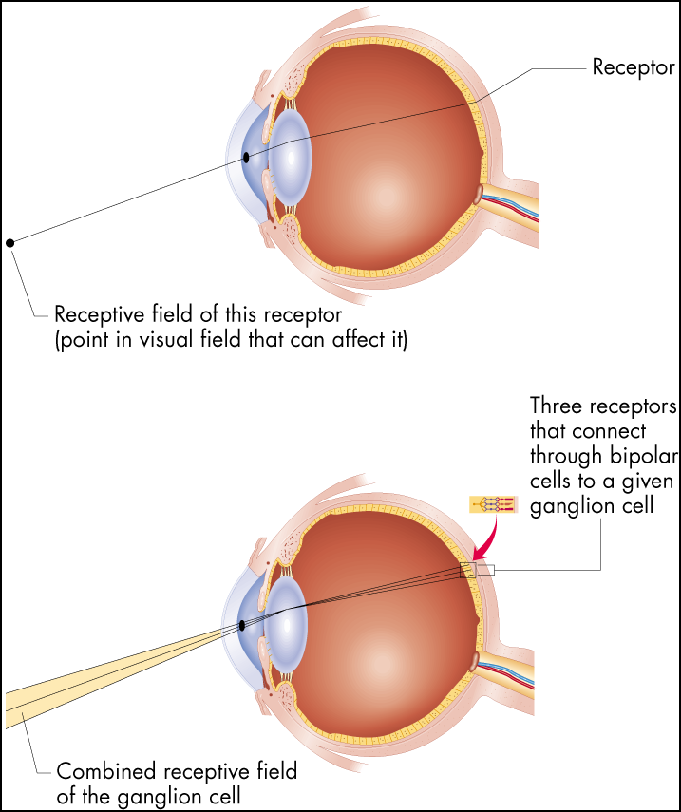
Receptive Fields
Figure 6.16 Receptive fields
The receptive field of a receptor is simply the area of the visual field from which light strikes that receptor. For any other cell in the visual system, the receptive
field is determined by which receptors connect to the cell in question.

Slide 37
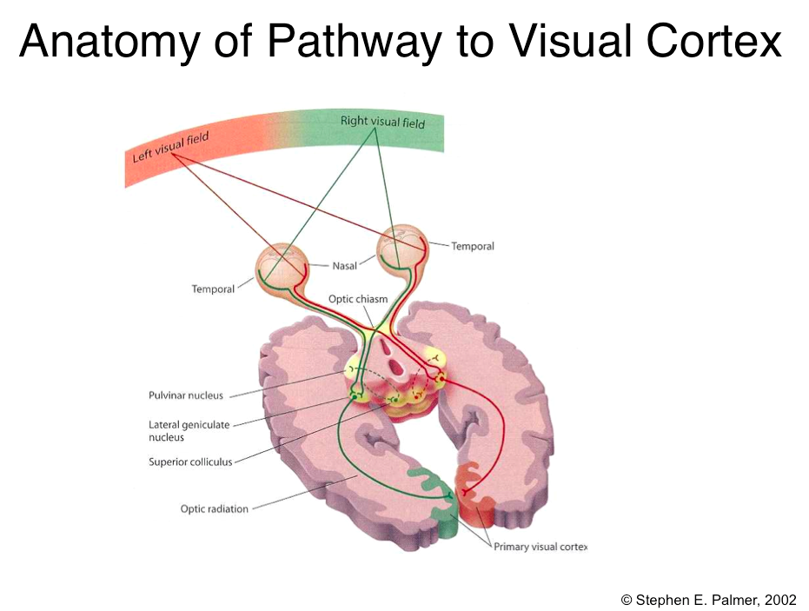

Slide 38
Visual Cortex
Cortical Area V1
aka:
Primary visual cortex
Striate cortex
Brodman’s area 17
© Stephen E. Palmer, 2002

Slide 39
Cortical Receptive Fields
Single-cell recording from visual cortex
David Hubel & Thorston Wiesel
© Stephen E. Palmer, 2002

Slide 40
Cortical Receptive Fields
Single-cell recording from visual cortex
© Stephen E. Palmer, 2002

Slide 41
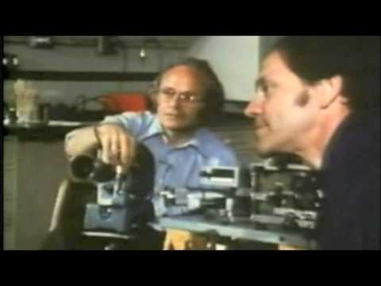
https://www.youtube.com/watch?v=IOHayh06LJ4

Slide 42
Cortical Receptive Fields
Three classes of cells in V1
Simple cells
Complex cells
Hypercomplex cells
© Stephen E. Palmer, 2002

Slide 43
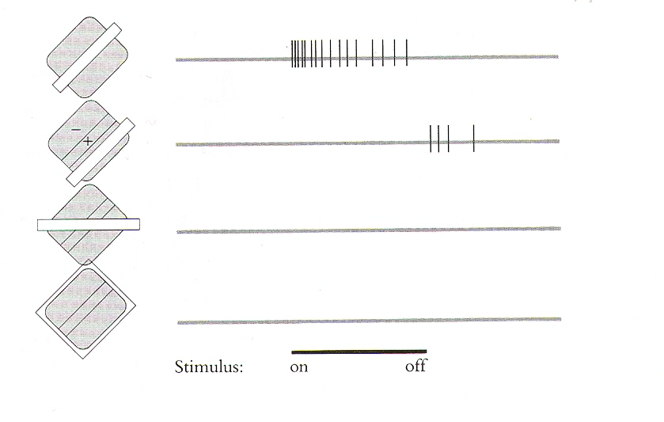
Orientation Selectivity in V1

Slide 44
Cortical Receptive Fields
Simple Cells: “Line Detectors”
© Stephen E. Palmer, 2002

Slide 45
Cortical Receptive Fields
Simple Cells: “Edge Detectors”
© Stephen E. Palmer, 2002

Slide 46
Cortical Receptive Fields
Constructing a line detector
© Stephen E. Palmer, 2002

Slide 47
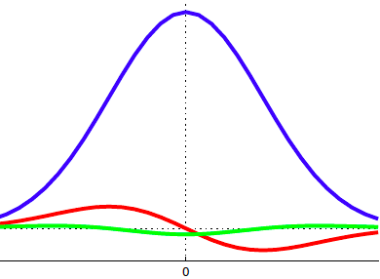
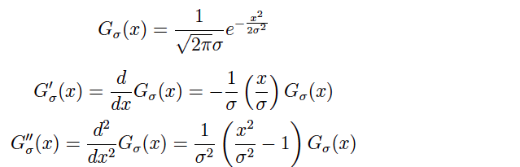
The 1D Gaussian and its derivatives

Slide 48
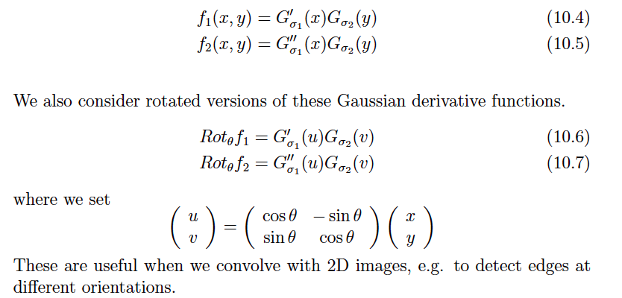
Oriented Gaussian Derivatives in 2D

Slide 49


Oriented Gaussian First and Second Derivatives

Slide 50
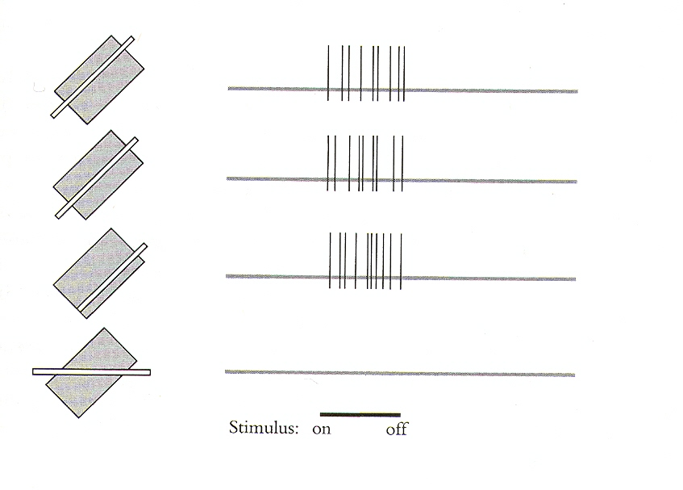
Receptive fields of complex cells

Slide 51
Cortical Receptive Fields
Constructing a Complex Cell
© Stephen E. Palmer, 2002

Slide 52
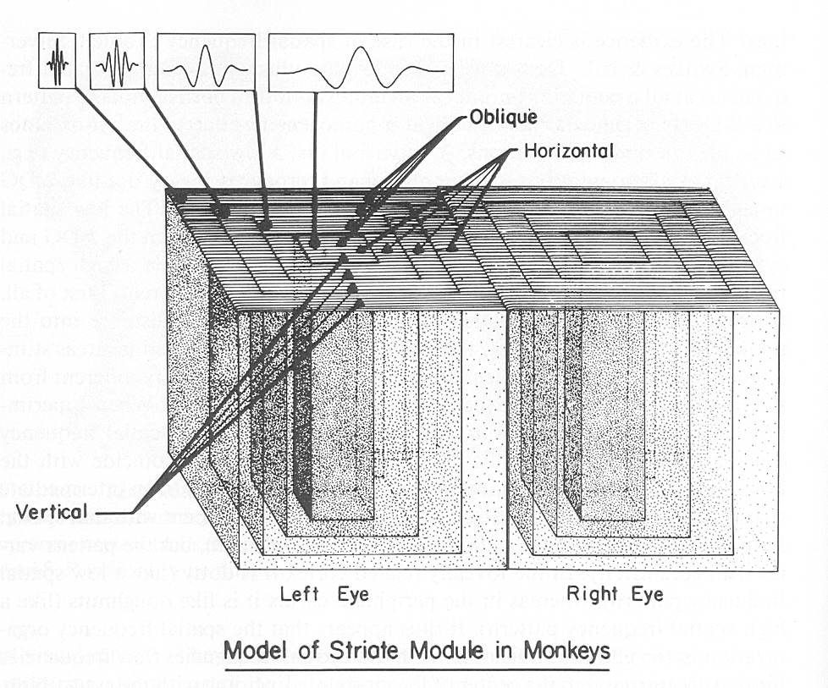
Hypercolumns in visual cortex

Slide 53
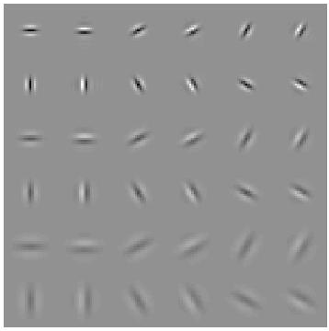
Modeling hypercolumns
Elongated directional Gaussian derivatives
Gabor filters could be used instead
Multiple orientations, scales
Notes:
No response to intensity ramps -- important benefit compared to simple comparison of intensities at i and j

Slide 54
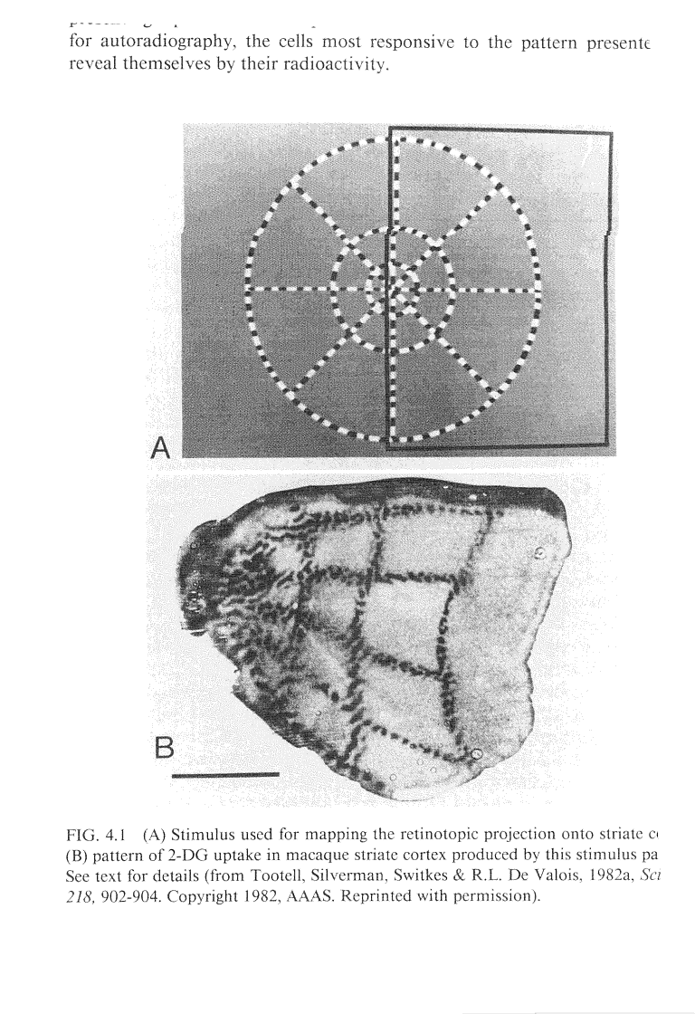
Mapping from Retina to V1

Slide 55
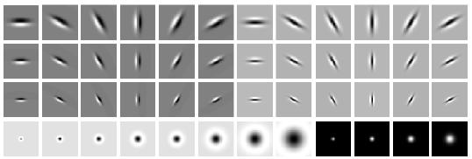
Overcomplete representation: filter banks
LM Filter Bank
Code for filter banks: www.robots.ox.ac.uk/~vgg/research/texclass/filters.html

Slide 56

Image from http://www.texasexplorer.com/austincap2.jpg
Kristen Grauman

Slide 57
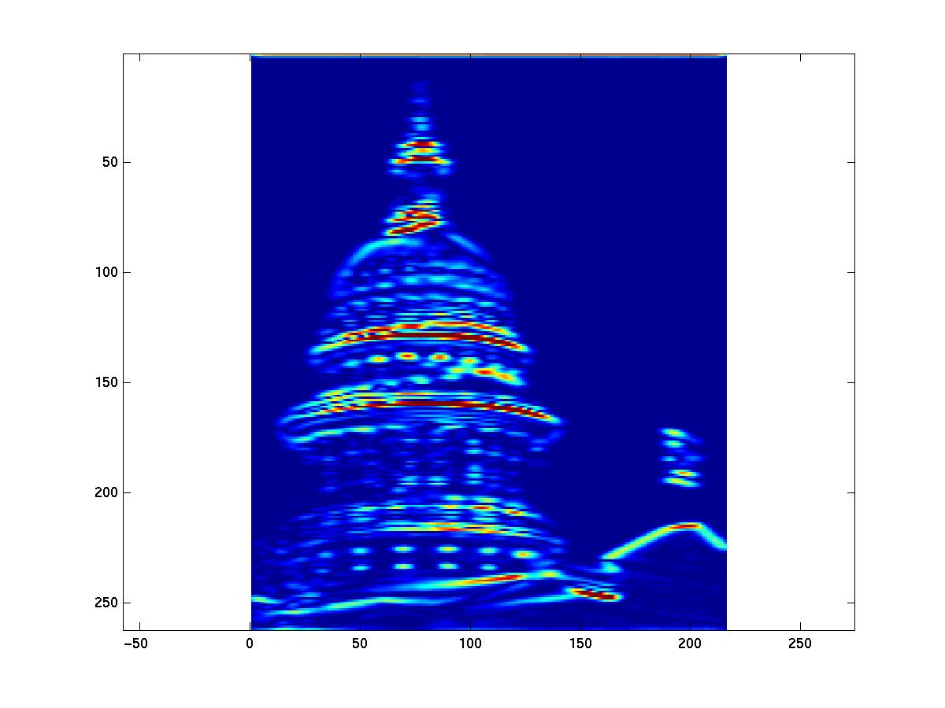
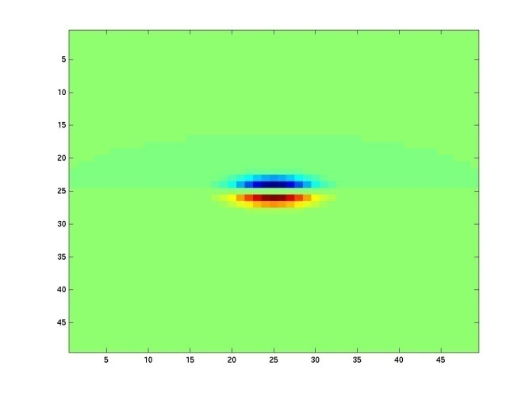
Showing magnitude of responses
Kristen Grauman

Slide 58
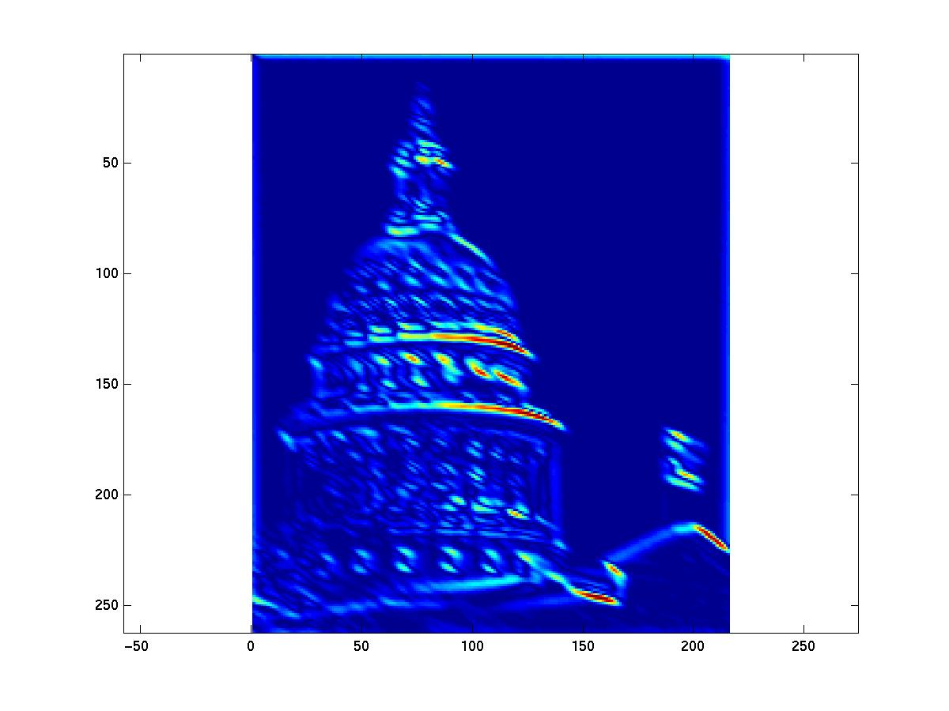
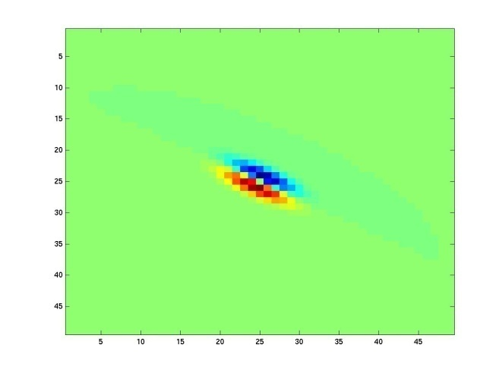
Kristen Grauman
Notes:
2

Slide 59
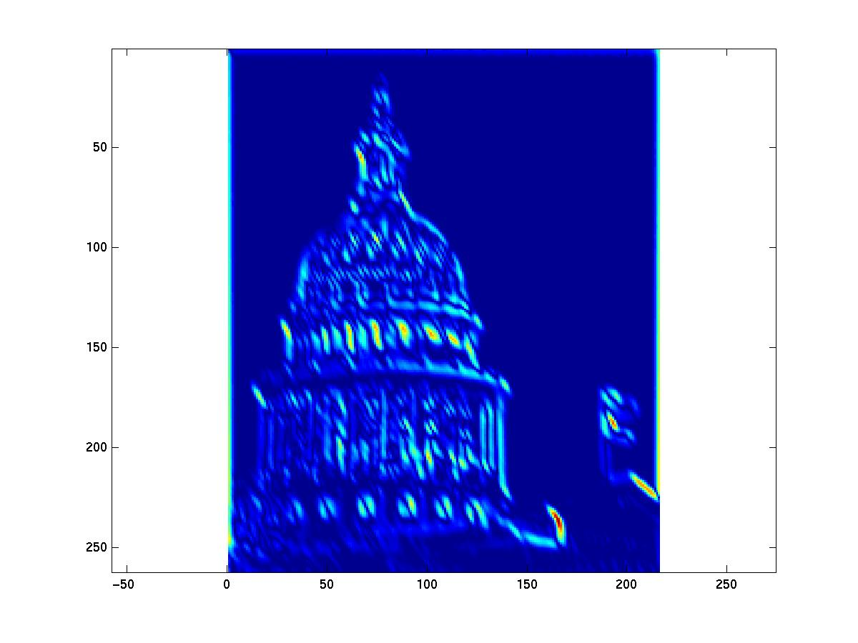
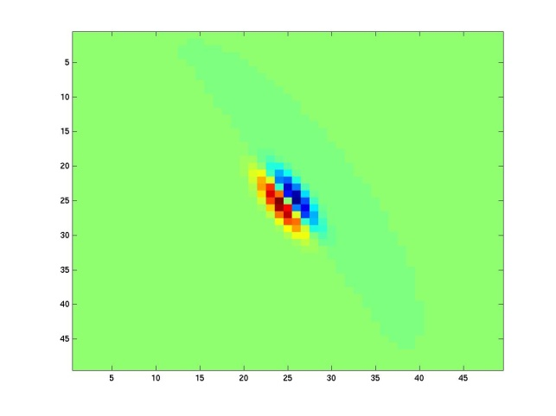
Kristen Grauman
Notes:
3

Slide 60
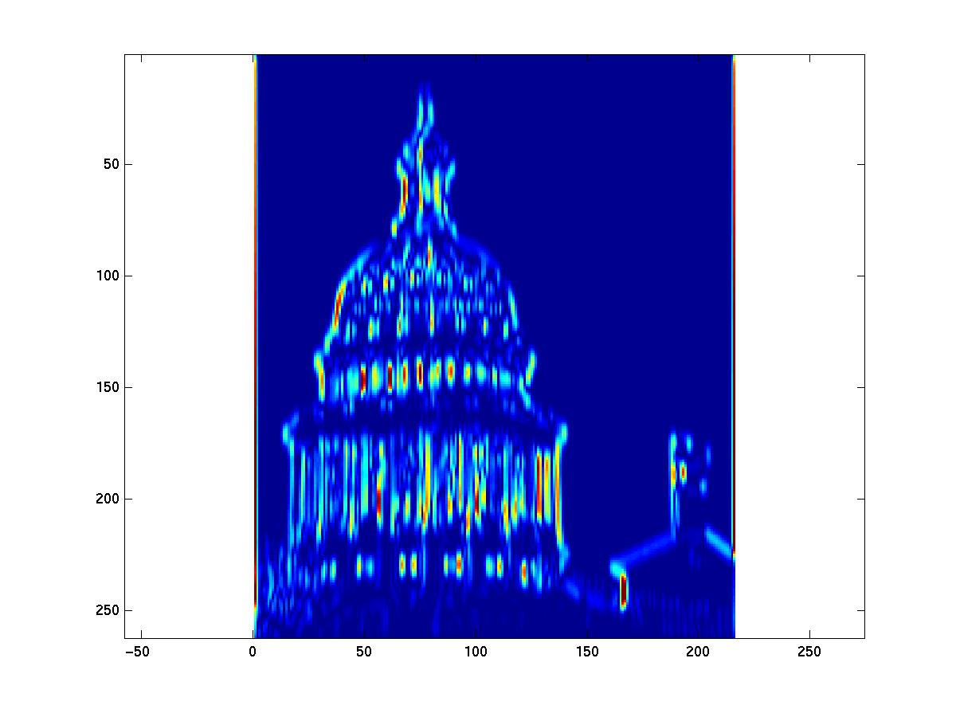
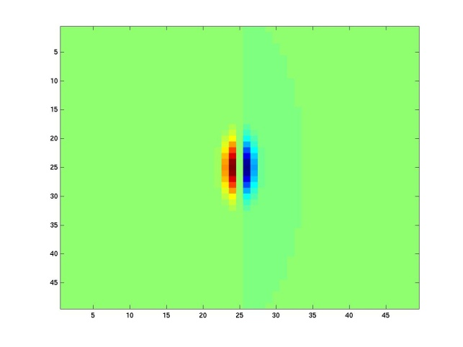
Kristen Grauman
Notes:
4

Slide 61
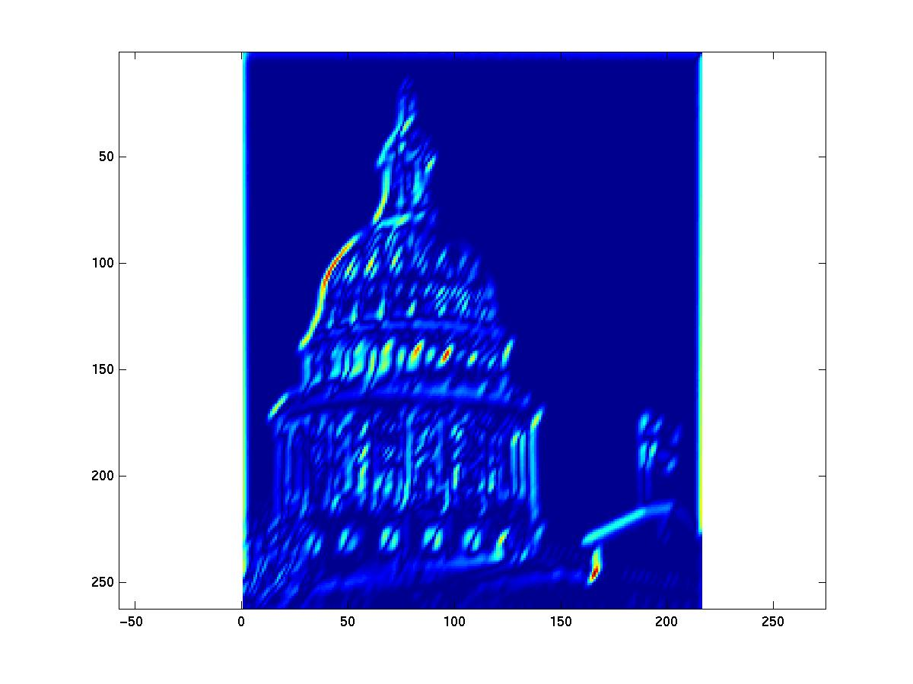
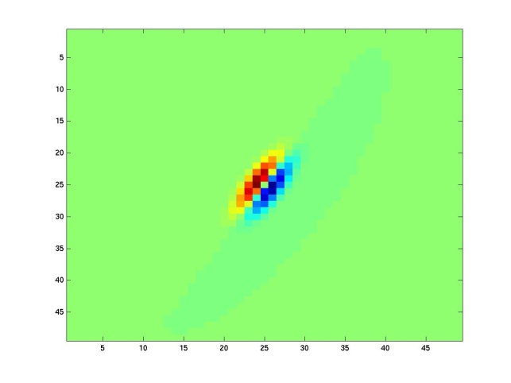
Kristen Grauman

Slide 62
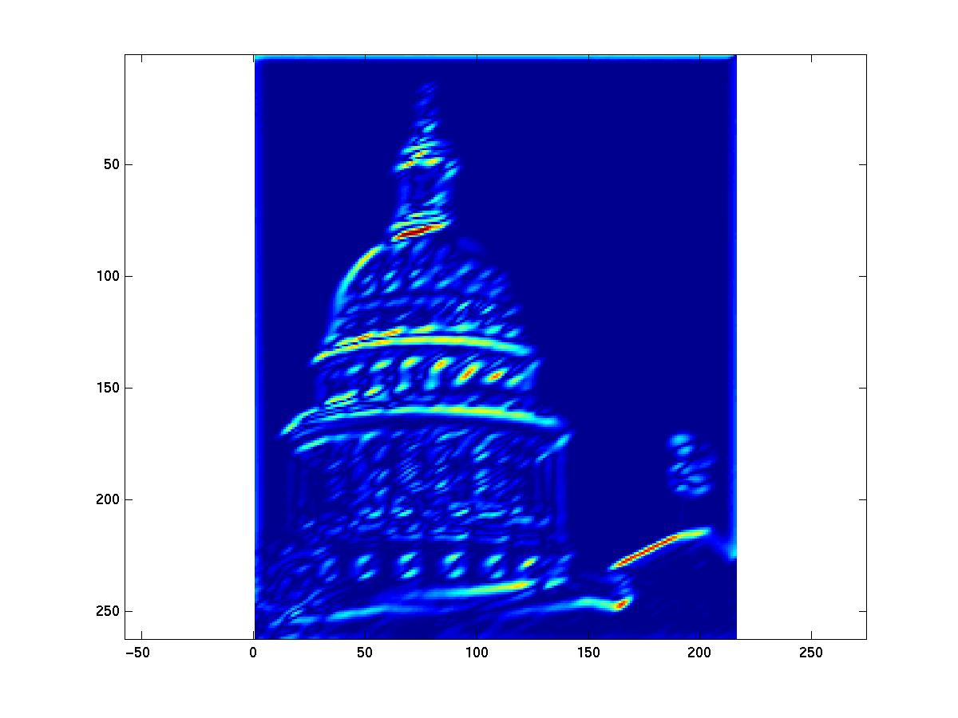
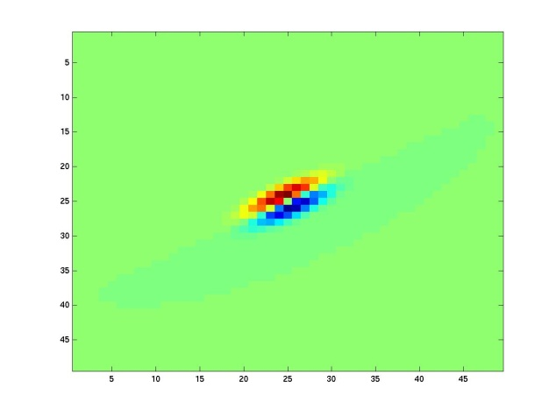
Kristen Grauman
Notes:
6

Slide 63
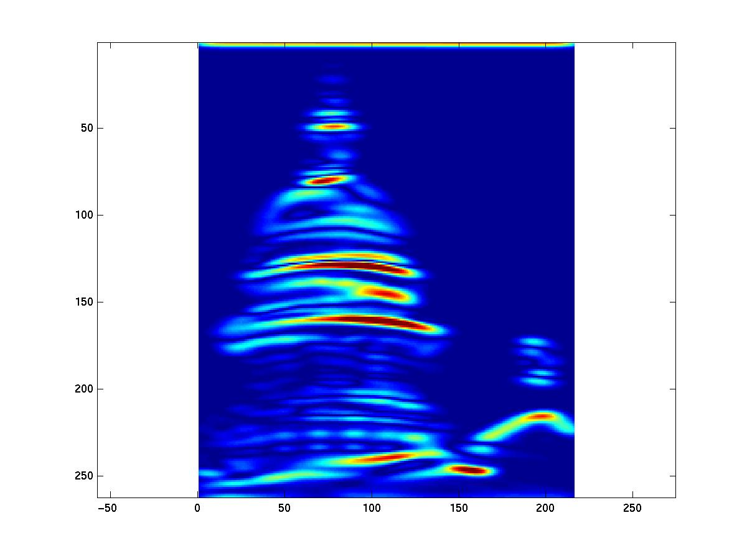
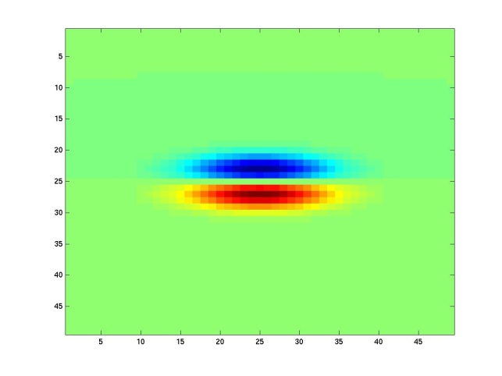
Kristen Grauman
Notes:
7

Slide 64
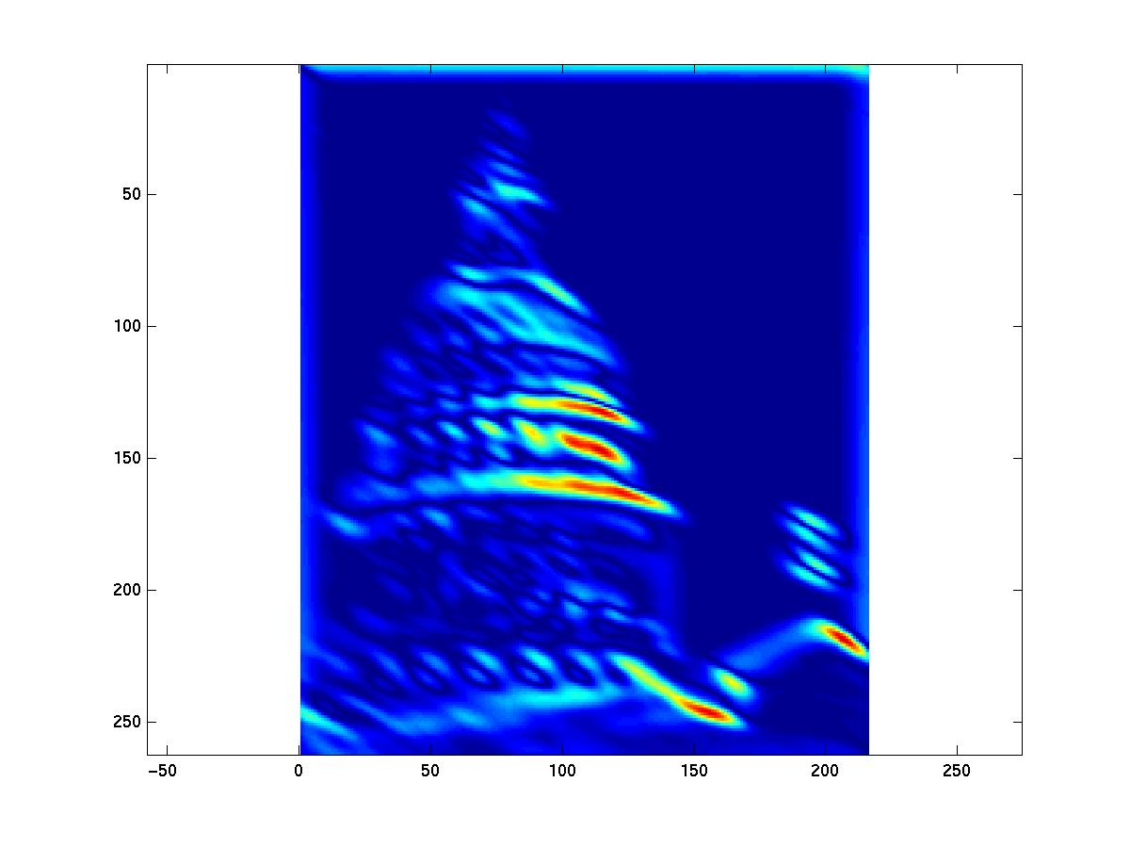
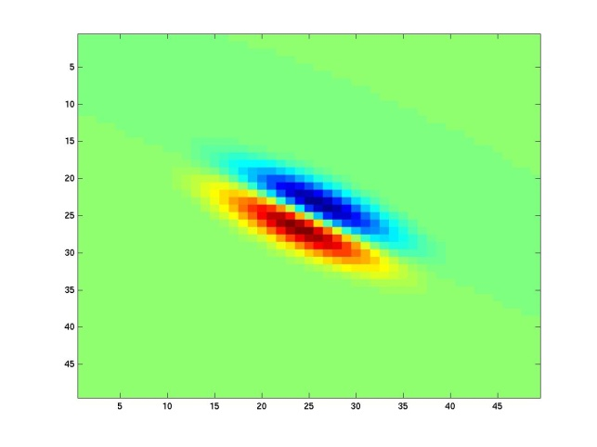
Kristen Grauman
Notes:
8

Slide 65
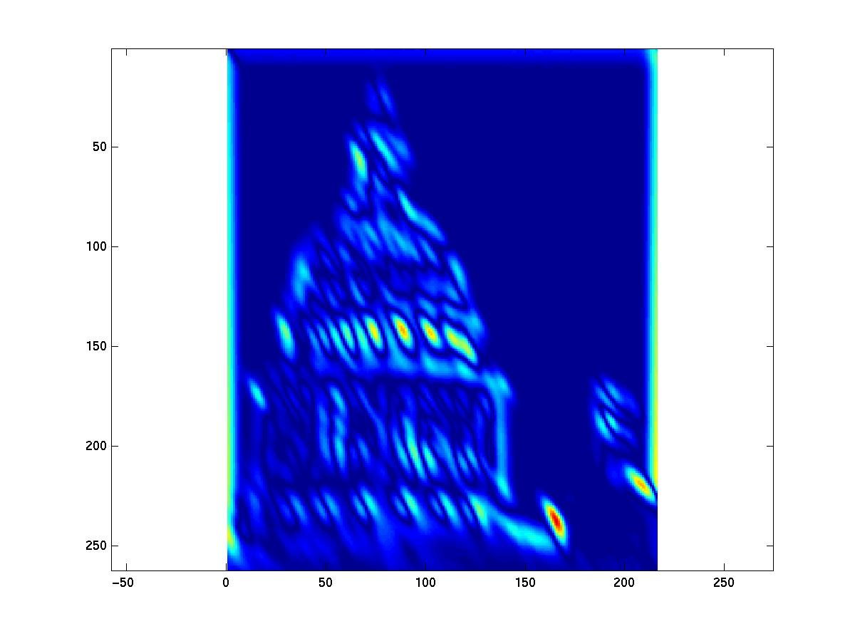
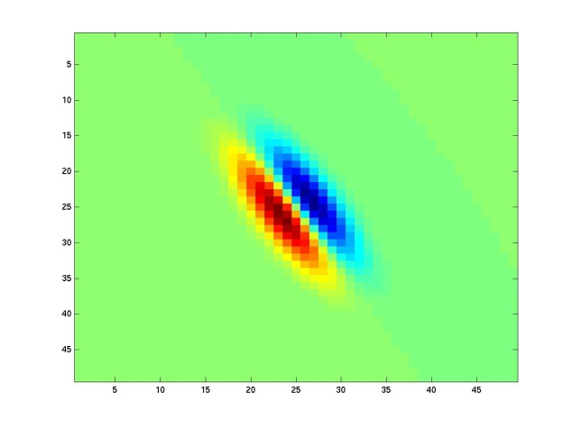
Kristen Grauman
Notes:
9

Slide 66


Kristen Grauman
Notes:
10

Slide 67


Kristen Grauman
Notes:
11

Slide 68


Kristen Grauman
Notes:
12

Slide 69


Kristen Grauman
Notes:
13

Slide 70


Kristen Grauman
Notes:
14

Slide 71


Kristen Grauman
Notes:
15

Slide 72


Kristen Grauman
Notes:
16

Slide 73


Kristen Grauman

Slide 74


Kristen Grauman
Notes:
18

Slide 75


Kristen Grauman

Slide 76
Two questions of texture modeling
What are the texture features (textons)?
Pixels
Pixel patches
Outputs of V1-like filters
Clusters of patches / filter outputs
CNN features
Etc.
How do we aggregate statistics
Various types of histograms
Implicit or explicit

Slide 77


Pixel Histograms
Slide by Erik Learned-Miller

Slide 78

Pixel Histograms
Slide by Erik Learned-Miller

Slide 79
Gray value histogram comparisons
They’re equal
Slide by Erik Learned-Miller

Slide 80
Going up from pixels: V1 filter-banks
LM Filter Bank

Slide 81






Can you match the texture to its histogram?
Filters
A
B
1
2
C
3
Mean abs responses

Slide 82



Slightly fancier: histogram for each filter
Filter bank
Input image

Slide 83

Filter response histograms

Slide 84


Adding spatial structure
A separate histogram for each region.
Slide by Erik Learned-Miller

Slide 85




Image Representations: Histograms
Images from Dave Kauchak
Joint histogram
Requires lots of data
Loss of resolution to avoid empty bins
Marginal histogram
Requires independent features
More data/bin than joint histogram

Slide 86




Ex: SIFT descriptor [Lowe’99]
distribution of the gradient over an image patch
image patch
gradient
3D histogram
x
→
→
y
4x4 location grid and 8 orientations (128 dimensions)
very good performance in image matching [Mikolaczyk and Schmid’03]

Slide 87




Gradient Histograms pop-up everywhere
HOG descriptor
Gist Descriptor
Freeman and Roth IAFGR 1995
Lowe ICCV1999
Oliva & Torralba, 2001
Belongie et al, 2001
Dalal &Triggs CVPR05
Generalized Shape Context
Binning achieves invariance to small patch offsets

Slide 88



Adaptive Representations
Images from Dave Kauchak
Adaptive binning
Better data/bin distribution, fewer empty bins
Can adapt available resolution to relative feature importance
Space Shuttle Cargo Bay

Slide 89

Clustering: very adaptive representations
Images from Dave Kauchak
EASE Truss Assembly
Clusters / Signatures
“super-adaptive” binning
Does not require discretization along any fixed axis
Space Shuttle Cargo Bay

Slide 90

Patch Features
…

Slide 91
dictionary formation
…

Slide 92
Clustering (usually k-means)
…
Vector quantization
Slide credit: Josef Sivic

Slide 93

Clustered Image Patches (“Bag of Visual Words”)
Fei-Fei et al. 2005

Slide 94

Analogy to documents
Of all the sensory impressions proceeding to the brain, the visual experiences are the dominant ones. Our perception of the world around us is based essentially on the messages that reach the brain from our eyes. For a long time it was thought that the retinal image was transmitted point by point to visual centers in the brain; the cerebral cortex was a movie screen, so to speak, upon which the image in the eye was projected. Through the discoveries of Hubel and Wiesel we now know that behind the origin of the visual perception in the brain there is a considerably more complicated course of events. By following the visual impulses along their path to the various cell layers of the optical cortex, Hubel and Wiesel have been able to demonstrate that the message about the image falling on the retina undergoes a step-wise analysis in a system of nerve cells stored in columns. In this system each cell has its specific function and is responsible for a specific detail in the pattern of the retinal image.
China is forecasting a trade surplus of $90bn (£51bn) to $100bn this year, a threefold increase on 2004's $32bn. The Commerce Ministry said the surplus would be created by a predicted 30% jump in exports to $750bn, compared with a 18% rise in imports to $660bn. The figures are likely to further annoy the US, which has long argued that China's exports are unfairly helped by a deliberately undervalued yuan. Beijing agrees the surplus is too high, but says the yuan is only one factor. Bank of China governor Zhou Xiaochuan said the country also needed to do more to boost domestic demand so more goods stayed within the country. China increased the value of the yuan against the dollar by 2.1% in July and permitted it to trade within a narrow band, but the US wants the yuan to be allowed to trade freely. However, Beijing has made it clear that it will take its time and tread carefully before allowing the yuan to rise further in value.
sensory, brain,
visual, perception,
retinal, cerebral cortex,
eye, cell, optical
nerve, image
Hubel, Wiesel
China, trade,
surplus, commerce,
exports, imports, US,
yuan, bank, domestic,
foreign, increase,
trade, value

Slide 95



Object
Bag of ‘words’

Slide 96



Slide 97
Image representation
frequency
…..
codewords

Slide 98









learning
recognition
codewords dictionary
feature detection
& representation
image representation
category
decision
category models
(and/or) classifiers

Slide 99










Scene Classification (Renninger & Malik)
beach
mountain
forest
city
street
farm
kitchen
livingroom
bedroom
bathroom

Slide 100
Image classification can be pre-attentive!
On a task of judging animal vs no animal, humans can make mostly correct saccades in 150 ms (Kirchner & Thorpe, 2006)
Comparable to synaptic delay in the retina, LGN, V1, V2, V4, IT pathway.
Doesn’t rule out feed back but shows feed forward only is very powerful
Detection and categorization are practically simultaneous (Grill-Spector & Kanwisher, 2005)

Slide 101
Texton Histogram Matching

Slide 102
Discrimination of Basic Categories
texture model

Slide 103
Discrimination of Basic Categories
texture model
chance

Slide 104
Discrimination of Basic Categories
texture model
37 ms
chance

Slide 105
Discrimination of Basic Categories
texture model
50 ms
chance

Slide 106
Discrimination of Basic Categories
texture model
69 ms
chance

Slide 107
Discrimination of Basic Categories
texture model
37 ms
50 ms
69 ms
chance

Slide 108

Scene Recognition using Texture

Slide 109


Slide 110

Convolutional Neural Networks

